Slide 1
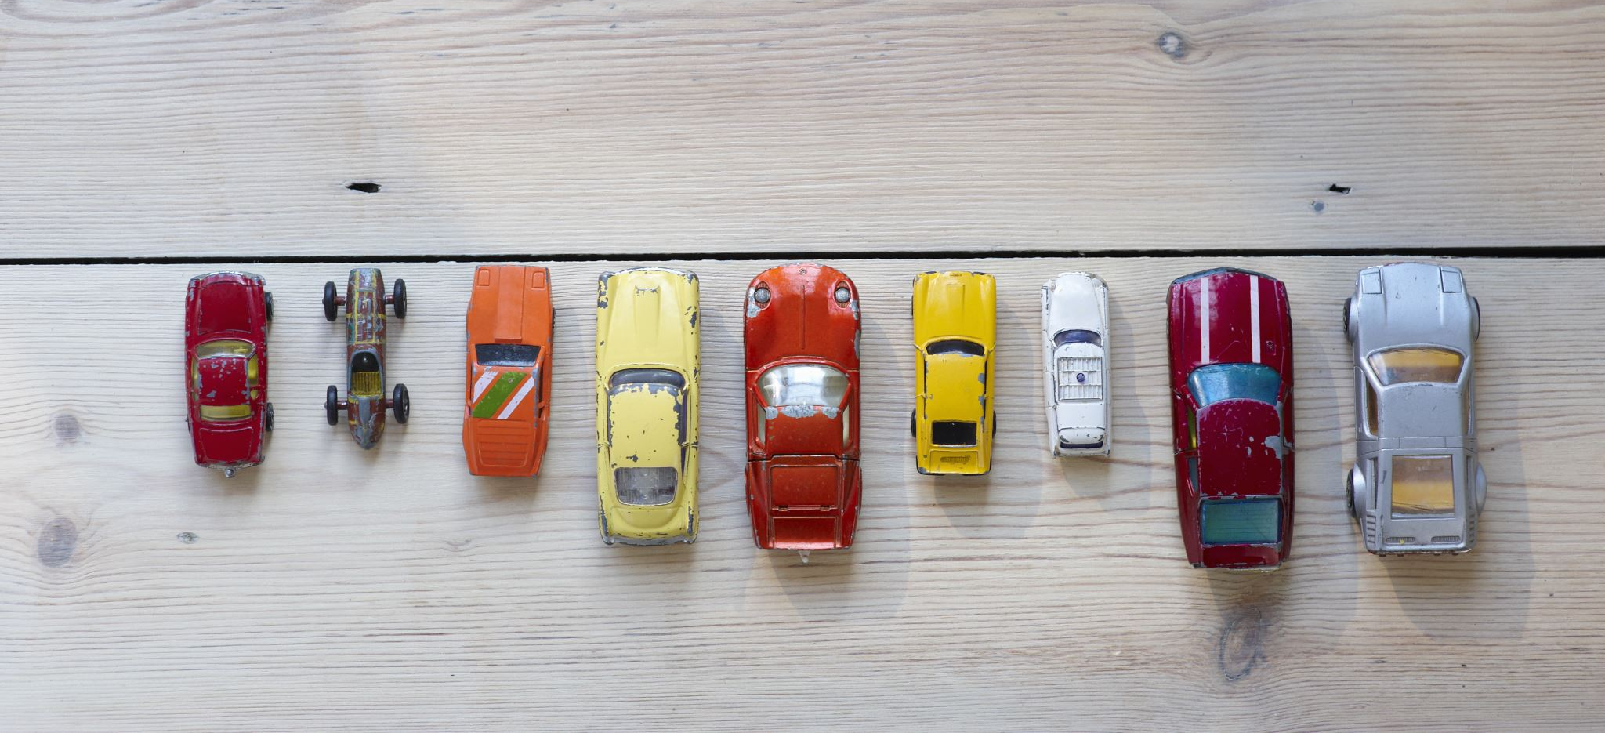
CAR SALES ANALYSIS

Slide 2

Project Title: Car Price Dataset Analysis
Presented by: [Your Name]
Course/Department: [Your Course Info]
Date: [Presentation Date]

Slide 3

Introduction
Analyzed a car price dataset using Python libraries.
Explored price trends and influential factors.
EDA techniques used to extract insights.
Used pandas, matplotlib, and seaborn.
Key columns: Brand, Price, Mileage, Year.
Performed data cleaning and visualization.

Slide 4

Dataset Overview
Loaded CSV dataset using pandas.
Previewed data using head() and info().
Columns include Brand, Year, Mileage, Price.
Checked data types and null values.
Identified some missing entries.

Slide 5
Handling Missing Values
Used isnull().sum() to detect missing data.
Removed rows with missing values using dropna().
Ensured consistency and completeness in data.
Prepared data for accurate analysis.

Slide 6
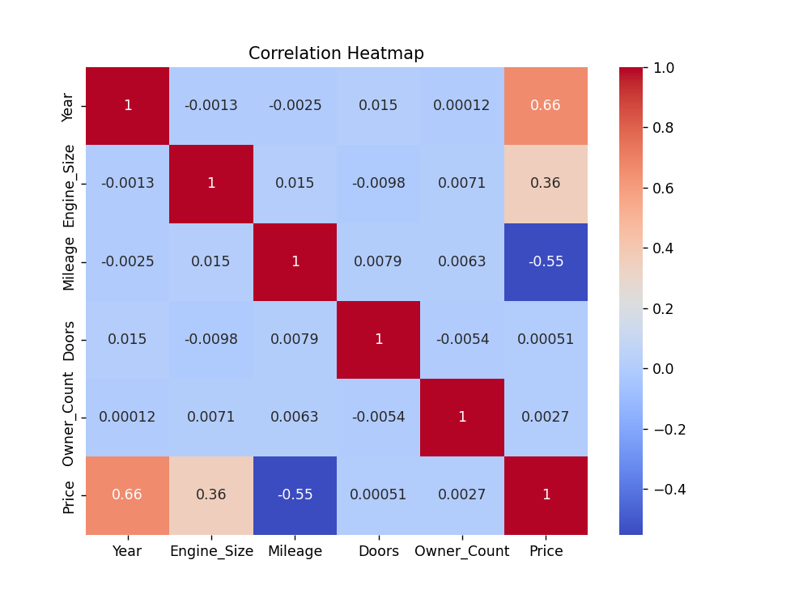
Correlation Heatmap
Generated heatmap with seaborn.
Shows correlation between numeric variables.
Price shows both positive and negative correlations.
Heatmap aids in feature selection.

Slide 7
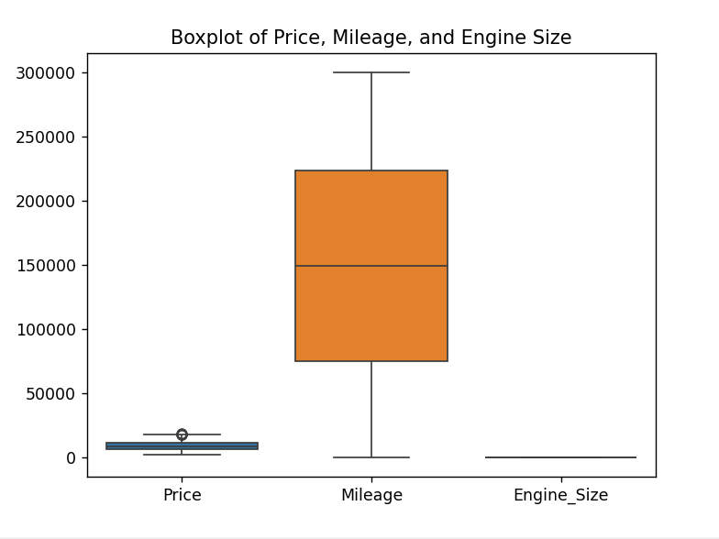
Boxplot for Outliers
Boxplot of Price, Mileage, Engine Size.
Reveals outliers and data distribution.
Outliers mainly found in Price and Mileage.
Highlights potential data issues.

Slide 8
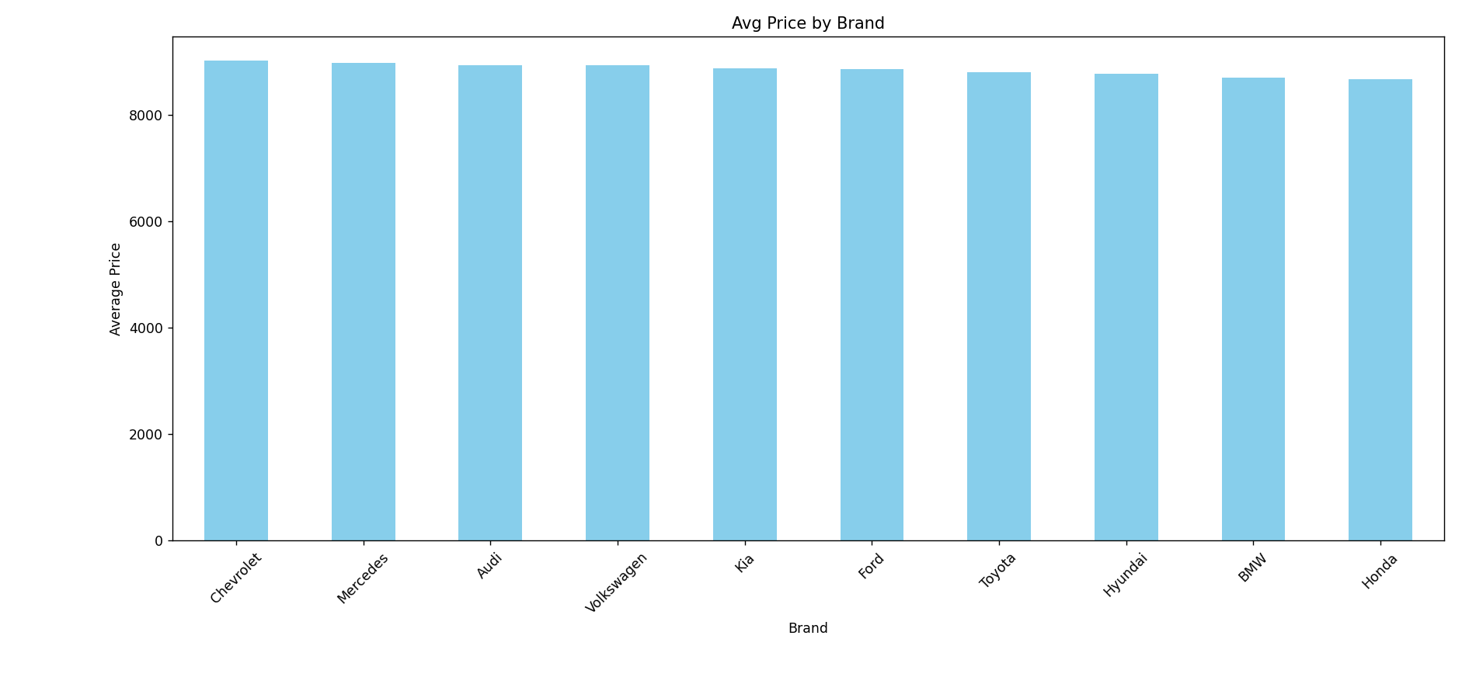
Avg Price by Brand
Bar graph of average price per brand.
Used groupby and mean to calculate values.
Brands sorted by average price.
Distinguishes premium from budget brands.

Slide 9
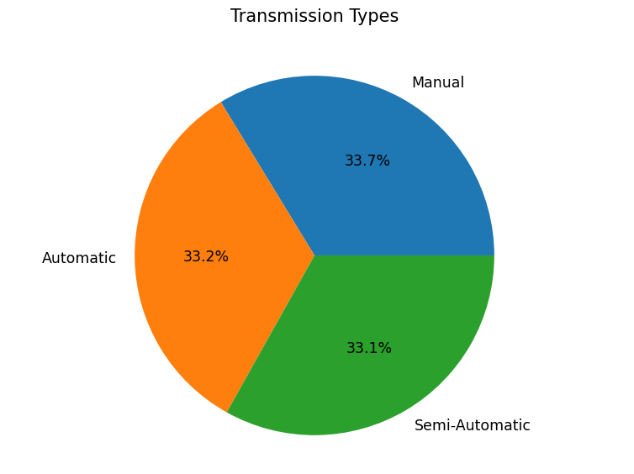
Transmission Types
Pie chart of transmission types.
Used value_counts() for counts.
Autopct shows percentages clearly.
Highlights popularity of each type.

Slide 10
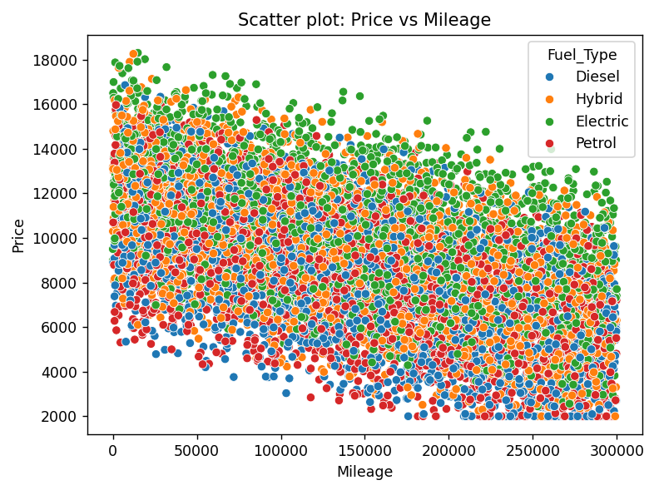
Price vs Mileage
Scatter plot: Price vs Mileage.
Hue indicates Fuel Type.
Shows inverse relationship between Price and Mileage.
Fuel types add dimension to the analysis.

Slide 11
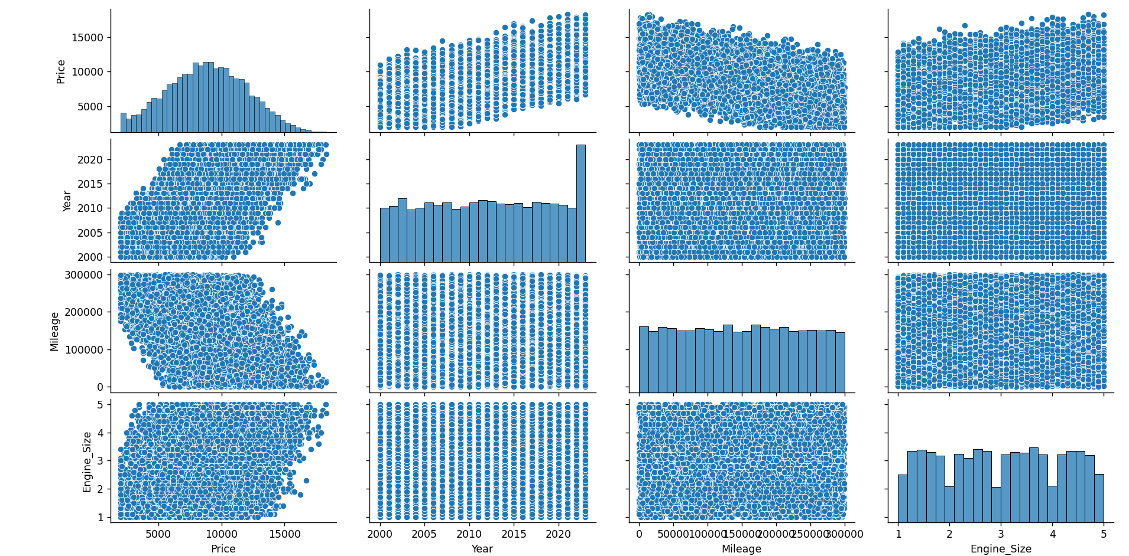
Pair Plot
Pair plot of Price, Year, Mileage, Engine Size.
Diagonal plots show distributions.
Other plots show feature relationships.
Useful for spotting patterns visually.

Slide 12
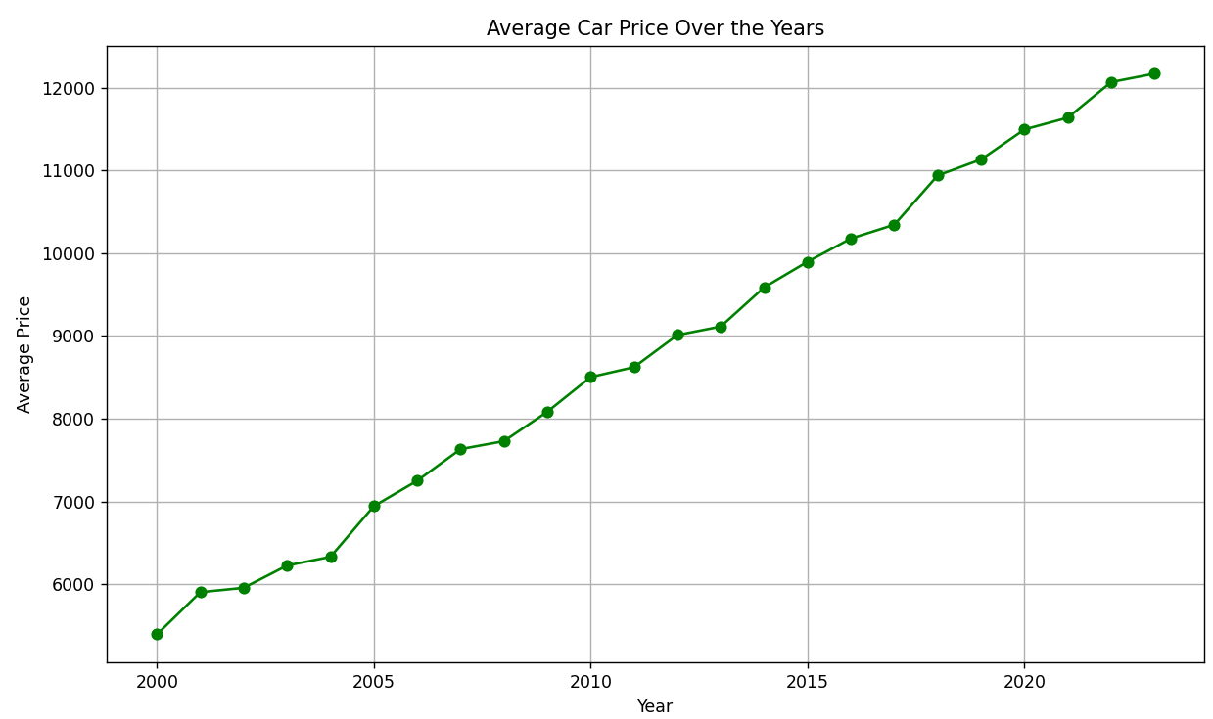
Line Chart - Price Over Years
Line chart shows avg price by year.
Created using groupby and plot().
Tracks pricing trends across years.
Helps understand depreciation or value increase.

Slide 13

Key Insights
High price linked to premium brands.
More mileage lowers car value.
Engine size may influence price.
Transmission and Year are important variables.

Slide 14

Challenges
Data cleaning was required for accuracy.
Outliers needed special attention.
Visualization choices were important.
Iterative analysis gave better clarity.

Slide 15

Tools Used
pandas: data manipulation.
matplotlib: plotting graphs.
seaborn: advanced visualization.
Jupyter Notebook: interactive coding.
CSV: data input format.

Slide 16

Conclusion
EDA provided key insights into car pricing.
Visuals revealed important trends.
Python tools made analysis efficient.
Findings support informed decision-making.

Slide 17

Importance of EDA
EDA reveals structure and trends.
Identifies anomalies and patterns.
Essential before applying ML.
Supports accurate conclusions.

Slide 18
Thank You

